Slide 1

Hope Clinic: Dynamic Questionnaire for Client Feedback
Kate Chi, Will Yu
04/05/2023

Slide 2
Background
Billy’s Expectation
A form that can pilot
Dynamic
Expected Outcomes
Qualification
Satisfactions
Qualitative Effectiveness
What we come up with
A prototype
Dynamic: According to differents departments
Notes:
-Billy hopes to develop a form that could record clients’ qualifications for clinic’s program and measure their satisfactions.
-A dynamic form that could automatically fit the following questions according to each answer clients have provided.
-can quickly understand and classify customer needs (prefer to use a web-based form that both computer and cellphone can fill out).
-that meet the sponsor’s need
-try and error, see if it is useful in practical, help us to modify it
-build a benefit evaluation, To make sure that the questionnaire system we designed is effective

Slide 3
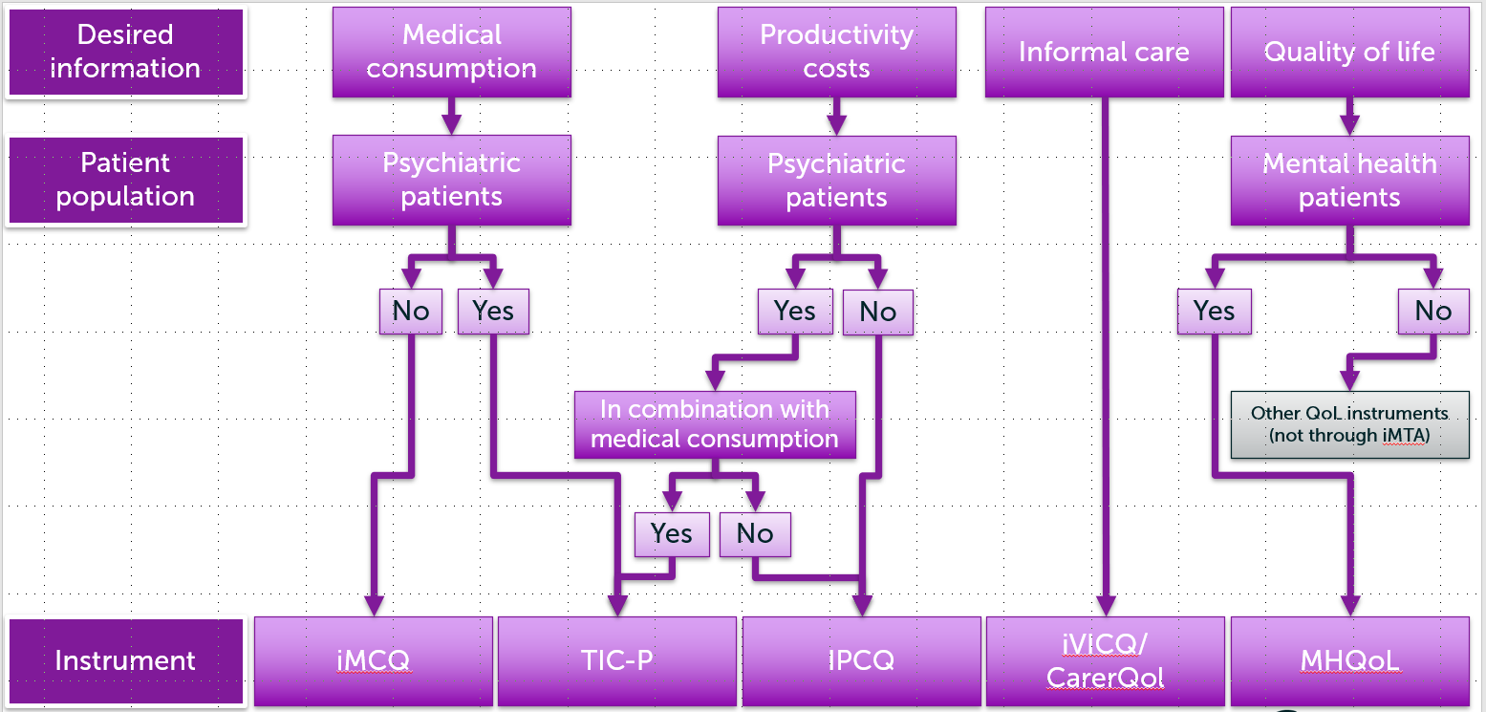
SERVQUAL
Commonly used in patient experience surveys in low-income countries.
Questionnaire: iPCQ & iMCQ
Generic questionnaires can be used in every indication.
Literature Research

Slide 4
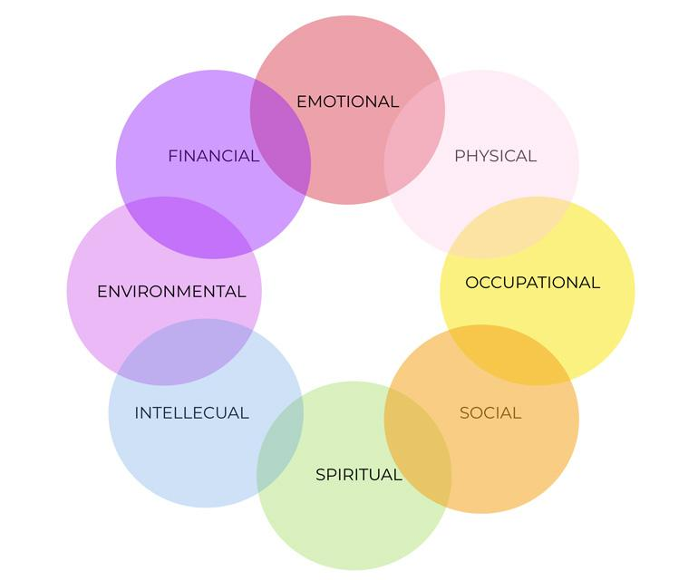
MHSIP
Services within seven domains and asks respondents to state to what degree they agree or disagree with them.
Questionnaire: GAD-7 & PHQ-9
Validated questionnaires, developed and certified by medical institutions and experts
8 Dimensions of Personal Wellness
Literature Research

Slide 5
Type of Service
Medical Care
Appointment
Free primary care
Help getting public insurance
Provided medicine
Dental Care
Appointment
Uninsured
Preventive Care
Food
Groceries pantry
Walk-up groceries
Food delivery
Hot meals
Diaper pantry
Behavioral Health
Appointment
Screen for some mental illness
Connect patients to third-parties
Notes:
-since we are going to talk about our initial conception with flow diagram in the next page, I am going to introduce the main services Hope Clinic are provided helping you have a better understanding later
-These services are all slightly different in the details
-Take into account when designing the questionnaire to ensure that customers can fill it out patiently

Slide 6
Questionnaire: First Draft
Food Questions
General Questions
Name / Birth
Do you have insurance? (Yes/No)
What types of service did you have last time? (Medical Care / Dental Care / Behavioral Health)
Medical Questions
Dynamic
Dental Questions
Behavioral Questions

Slide 7
Questionnaire: First Draft
Feedback from Billy
Should be more general, do not separate into different departments to collect the data.
More narrative questions.
The purpose of the form is to get to know how patient’s life is and how to help them improve.
Considering the time limits, cannot implement the form before the end of this semester.
Focus on the logic and methodology of designing an appropriate feedback form.

Slide 8
Goals
Sponsor’s Expectation
Develop a complete feedback system
Expected Outcomes
A prototype of the form
Establish a chart analysis mechanism
Execute our prototype with virtual data
Collect some feedback from staff for our designed feedback form
Notes:
-can quickly understand and classify customer needs (prefer to use a web-based form that both computer and cellphone can fill out).
-that meet the sponsor’s need
-try and error, see if it is useful in practical, help us to modify it
-build a benefit evaluation, To make sure that the questionnaire system we designed is effective

Slide 9
Questionnaire: Final Version
General Questions
Language
Do you have insurance? (Yes/No)
Food Questions
Dynamic
General Questions
Ask questions in the first person
Real-life example
Avoid obscure words
The order of questions
Designed to be completed in 8 minutes

Slide 10
Questionnaire: Final Version
Food Questions
Type | Question
Scale | I am able to afford the food I need for the past 6 months.
 | I am able to eat balanced meals for the past 6 months.
 | The food quality I had for the past 6 months is…
 | The food amount I had for the past 6 months is…
 | Since I started to visit Hope Clinic, my life quality has been better.
Narrative | Please share with us if there is any food security problem struggling your life in the past 4 weeks.
 | Please share with us what kind of change has happened since you visited Hope Clinic.
 | Please share with us how has our service improved your life.

Slide 11
Questionnaire: Final Version
General Questions
Type | Question
 | Food | Dental | Medical | Behavioral
Scale | Affordable Eat balanced Quality Amount Life quality | Dental problem Sensitivity Bleeding gum | Medical problem Difficulties with purchasing medicines Clearly understanding | Emotions experiencing Feel positive Behavioral problem
Narrative | Please share with us if there are any food security/dental/medical/behavioral problems struggling your life in the past 4 weeks.
 | Please share with us what kind of change has happened since you visited Hope Clinic.
 | Please share with us how has our service improved your life.

Slide 12
Outcomes
How to visit?
How to fill out the form?
Calling for reservation
Sending Email
Sending Email
Having appointment / Enjoying services
Plan to visit Hope Clinic
Having a reservation at the front desk
QR Code
QR Code
Walk-in
Notes:
-since we are going to talk about our initial conception with flow diagram in the next page, I am going to introduce the main services Hope Clinic are provided helping you have a better understanding later
-These services are all slightly different in the details
-Take into account when designing the questionnaire to ensure that customers can fill it out patiently

Slide 13
Prototype
Coded in Python using the PyQt package
Dynamic features
Radar map

Slide 14
Prototype
Dave vs. Johnny

Slide 15
Further
Study
Data Analysis
Sorting out customer feedbacks
Using Text Mining and Natural Language Processing techniques to decouple shared and unique features across responses
Visualization
Generating personal wellness wheel for clients
Forming weekly or monthly satisfaction chart for each model of care
Machine Learning
Predict when customers will visit
Simple auxiliary medical diagnosis (behavioral health)
Notes:
Develop a complete feedback system so that Hope Clinic can quickly understand and classify customer needs (prefer to use a web-based form that both computer and cellphone can fill out).

